Slide 1
Services

Slide 2
Services Overview
A Service is an application component to perform a longer-running operation while not interacting with the user or to supply functionality for other applications to use.
For example, a service might play music in the background while the user is in a different application, or it might fetch data over the network without blocking user interaction with an activity.
Services are given a high priority by the Android system and are typically among the last to be terminated in order to free up resources.

Slide 3
Services Overview
Three type of services
Foreground
Background
Bond

Slide 4
Foreground Service
A foreground service is a service that should have the same priority as an active activity and therefore should not be killed by the Android system, even if the system is low on memory.
It performs some operation that is noticeable to the user. Foreground services continue running even when the user isn't interacting with the app
For example, an audio app would use a foreground service to play an audio track.

Slide 5
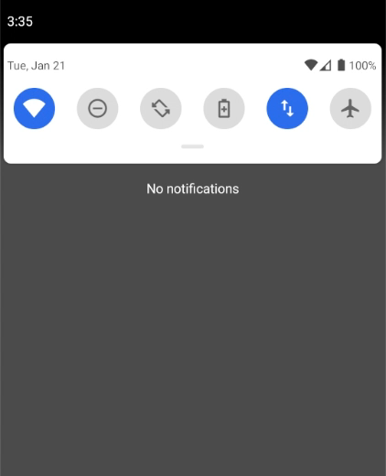
Foreground Service

Slide 6
Background Service
It is a service whose application is in background.
A background service performs an operation that isn't directly noticed by the user.
For example, if an app used a service to compact its storage, that would usually be a background service.
Because of recent restrictions (API level 26 or higher) on Android to improve battery life, all background work including periodic tasks should now be scheduled through the JobScheduler.

Slide 7
Bond Service
A service is bound when an application component binds to it by calling bindService().
A bound service offers a client-server interface that allows components to interact with the service, send requests, receive results, and even do so across processes with interprocess communication (IPC).
A bound service runs only as long as another application component is bound to it.
Multiple components can bind to the service at once, but when all of them unbind, the service is destroyed.

Slide 8
Basics
To create a service, you must create a subclass of Service or use one of its existing subclasses like IntentService.
<<abstract>>
Service
<<abstract>>
IntentService

Slide 9
Started Service vs. Bond Service
Started Services
Started by calling startService()
Usually for long running background tasks with no interactions or results.
Once started it runs in the background indefinitely, even if the component that started it is destroyed.
Synchronous processing mode.
Bond Service
Started by calling bindService()
Allows the launching component to interact with, and receive results from, the service.
Asynchronous processing mode.

Slide 10
Bond Service Example
Start a service to handle audio playback. The activity will include a user interface providing controls to the user for the purpose of pausing playback or skipping to the next track.
Similarly, the service will quite likely need to communicate information to the calling activity to indicate that the current audio track has completed and to provide details of the next track that is about to start playing.

Slide 11
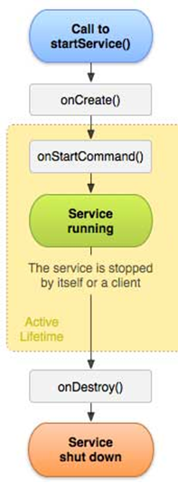
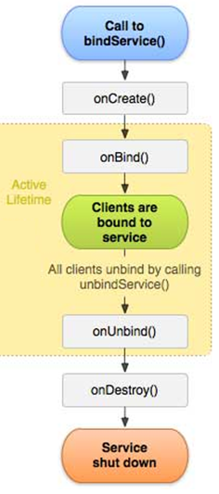
Lifecycle of Services
startService()
bindService()
Lifecycle: Started Service
Lifecycle: Bond Service

Slide 12
Lifecycle of Services
The most important callback methods you should override are:
onStartCommand()
The system calls this method when another component, such as an activity, requests that the service to be started, by calling startService().
Once this method executes, the service is started and can run in the background indefinitely.
If you implement this, it is your responsibility to stop the service when its work is done, by calling stopSelf() or stopService().

Slide 13
Lifecycle of Services
onBind()
The system calls this method when another component wants to bind with the service
In your implementation of this method, you must provide an interface that clients use to communicate with the service, by returning an IBinder.
You must always implement this method, but if you don't want to allow binding, then you should return null.

Slide 14
Lifecycle of Services
onUnbind()
The system calls this method when all clients have disconnected from a particular interface published by the service.
To disconnect from the service clients call unbindService()
onRebind()
The system calls this method when new clients have connected to the service, after it had previously been notified that all had disconnected in its onUnbind(Intent).

Slide 15
Lifecycle of Services
onCreate()
The system calls this method when the service is first created, to perform one-time setup procedures (before it calls either onStartCommand() or onBind()).
If the service is already running, this method is not called.
onDestroy()
The system calls this method when the service is no longer used and is being destroyed. Your service should implement this to clean up any resources such as threads, registered listeners, receivers, etc. This is the last call the service receives.

Slide 16
Service & Process
Local Service: by default, a service will run within the same main thread as the application process from which it was launched, referred to as a local service.
Remote Service: We can instruct a service to run within a separate process via its configuration change within the manifest file.

Slide 17
Service & Process
Manifest file entry:
<service android:name="MyService"
android:exported="false"
android:process=":myprocess">
</service>
The colon prefix indicates that the new process is private to the local application. If the process name begins with a lower case letter instead of a colon the process will be global and available for use by other components.

Slide 18
Intent Service
The IntentService class is a convenience class that sets up a worker thread for handling background tasks and handles each request in an asynchronous manner.
All that is required when using the IntentService class is that the onHandleIntent() method be implemented containing the code to be executed for each request.
Once the service has handled all queued requests, it simply exits.

Slide 19
Update
If your app targets API level 26 (Orio) or higher, the system imposes restrictions on using or creating background services unless the app itself is in the foreground.
If an app needs to create a foreground service, the app should call startForegroundService().That method creates a background service, but the method signals to the system that the service will promote itself to the foreground.
Once the service has been created, the service must call its startForeground() method within five seconds.

